Slide 1
Decision Trees

Slide 2
Decision Trees
  Commonly used for NPC behavior and animation control.
  Used to solve a classification problem:
    The state of the world is a set of attributes (or features) Who I can see, how far away they are, how much energy, …
    Given any state, there is one appropriate action
  Decision trees are:
    Fast to execute in code
    Easy to implement in a scripting language
    Easy to understand
    Easy to modify
  Can be used for machine learning

Slide 3
Decision Trees
  They are usually binary trees
    Nodes represent attribute tests
    One child for each possible outcome of the test
    Leaves represent classifications (actions)
    Can have the same classification for several leaves
  Each decision node has two child nodes
  Each node represents either:
    an Action
    Another Decision Node

Slide 4
Actions
  An action is a call to the game engine API
  The API defines callable functions in a game
    e.g. ShootAt(location), MoveTo(Position), etc.
  Action node is a leaf node
  Multiple leaf nodes can have the same action

Slide 5
Binary Decision Tree
  To execute a decision tree we start at the root node
  Evaluate the decision in the node
  Chose which node to move to based on the outcome of the decision
  Move to child node and repeat
  We stop when we reach an action node, where we perform the associated action

Slide 6
Decision Nodes
  These are obviously true/false nodes
    There are typically only two outcomes
  Node decisions will be based on game variables
    (global or local)
  These variables can have different types
    Boolean
    Enumeration
    Numeric
    Vector

Slide 7
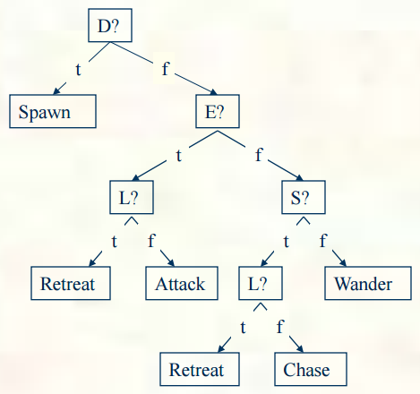
Decision Tree for Quake
  Just one tree
  Attributes: Enemy=<t,f> Low=<t,f> Sound=<t,f> Death=<t,f>
  Actions: Attack, Retreat, Chase, Spawn, Wander
  Could add additional trees:
      If I’m attacking, which weapon should I use?
      If I’m wandering, which way should I go?
      Can be thought of as just extending given tree (but easier to design)
      Or, can share pieces of tree, such as a Retreat sub-tree

Slide 8
Decision Nodes
  Generally we do not allow compound propositions
    Propositions containing AND, OR connectives
  This makes them more readable
    But requires bigger decision trees
    However, not all decisions will be examined
  Entire tree can be translated directly into if-else statements
  In OO game engines, the DT can delegate more complex processing to (optimised?) methods of instances
    This leaves the DT to maintain the simple decision making function

Slide 9
Efficiency
Balanced binary trees are more efficient
  Why?
Try to keep trees balanced if possible
Binary decision trees are about as efficient as more complex decision trees
However, for games AI, it may not be so simple
  not all decisions are equal
    e.g. is there an enemy within my LOS?
    put it further down the tree (even if it causes an unbalance)
Notes:
Linear search has linear time complexity: O(N)
Binary search has logarithmic time complexity: O(log N)
if b^{x} = n, then log_{b}n = x
If b=2 and n=no. of nodes then we are simply figuring out how many times we need to split the tree in half.

Slide 10
Implementation
Hard Coding
They can be implemented directly as a series of if-elseif statements
Nested inside each other
Very simple to do
Can be messy if rules change over time

Slide 11
Decision Tree Class
A decision tree consists of nodes
class DTNode:
def makeDecision() //recursively walks the tree!
DTNode has two subtypes/sub classes:
  Decision node
  Action Node
An action node simply contains the action to perform if we get there
class Action:
def makeDecision():
return this

Slide 12
Decision Nodes
  class Decision(DTNode):
  trueDTNode //if True
  falseDTNode //if False
  testValue
  getBranch()
  makeDecision():
  DTNode Branch = getBranch()
  Branch.makeDecision()
Pointers to other tree nodes
Internal or external knowledge to be tested

Slide 13
Decision Nodes
We may need to subclass the Decision nodes for each different type of test
  Equality, in range, etc.
  e.g.
  class FloatDecision (Decision):
  minValue
  maxValue
  def getBranch():
  if maxValue >= testValue >= minValue:
  return trueDTNode
  else:
  return falseDTNode

Slide 14
Action Node
An action node simply contains the action to perform if we get there
class ActionNode: DTNode
makeDecision()
doAction()

Slide 15
Random Decision Trees
  We can use randomness to make behaviour less mechanical/predictable
    Toss a coin to decide what branch to take.
    However, watch out for odd behaviour if executing with high frequency
    Store last choice and maintain this choice
    At some stage a different decision will force another action -> remove old choice
Notes:
Under Attack? -> Yes -> Defend
No -> Toss a coin -> H -> Patrol
T -> Stand still

Slide 16
Random Decision Trees
struct RandomDecision (Decision):
lastFrame = -1
lastDecision = false
def test():
if frame() > lastFrame + 1: # old
# Make a new decision
lastDecision = randomBoolean()
lastFrame = frame() # curr. frame num.
return lastDecision
Use frame # instead of decision variable

Slide 17
Random Decision Trees
NPC may start looking dumb if continuously doing the same thing
Add a timeout to the decision making algorithm
Can we still see a recurring pattern?
  add a random timeout!

Slide 18
Building Decision Trees
Decision trees can be constructed by hand
  But how do I decide which decisions should be made?
Decision trees are typically learned:
  Why? We don’t know how to decide on an action, so let the computer do the work
  Provide examples: many sets of attribute values and resulting actions
  An algorithm then constructs a tree from the examples e.g. ID3

Slide 19
ID3 - Iterative Dichotomiser 3
ID3 is a basic learning algorithm created by Ross Quinlan in 1986 “Induction of Decision Trees”
C4.5 and now C5.0 are updated and extended versions (look them up if you like)
A classification solving algorithm
  If we have categorical data, for example: hot, mild, and cold.
  If we have attribute-value pairs of data, for example: an attribute ‘temperature’ may have some discrete values ‘hot’, ‘mild’, and ‘cold’.
  If the objective value has discrete output values, for example ‘yes’, or ‘no’
Given some sample data, ID3 Learns the decision tree by constructing it top-down.
  Starting with the question “Which attribute should be tested at the root of the tree?”
Notes:
ID3: https://link.springer.com/content/pdf/10.1007/BF00116251.pdf
https://medium.com/machine-learning-guy/an-introduction-to-decision-tree-learning-id3-algorithm-54c74eb2ad55

Slide 20
ID3 - Iterative Dichotomiser 3
At each step in the algorithm, decide which attribute best classifies (divides up) the training data at that point.
We end up with a tree structure representing a hypothesis which works best for that training data.
But what is a good quantitative measure of the worth of an attribute?
“Knowledge once gained casts a faint light beyond its own immediate boundaries.”
– John Tyndall 1870
“On the Methods and Tendencies of Physical Investigation”

Slide 21
ID3 - Iterative Dichotomiser 3
Information Gain
Measures how well a given attribute separates the training examples according to their target classification
At each step ID3 picks the attribute with the highest gain
Information gain is therefore an Heuristic which we can estimate
But to understand information gain, we must understand entropy

Slide 22
ID3 - Iterative Dichotomiser 3
Entropy: a measure of disorder in a probability distribution.
Entropy for a set of examples, S, can be given as follows, (relative to a binary classification task):
Entropy(S) = -p₊ log₂(p₊) – p₋log₂(p₋)
Where p₊ is the proportion of positive examples in S and p₋ is the proportion of negatives (p₊ and p₋ can be seen simply as two distinct categories).
If all examples belong to the same label, entropy is 0. If all examples are equally mixed, entropy is 1.
In general, entropy represents a level of uncertainty.
Notes:
We negate the values since if you take the Log of a probability you will get a negative number.

Slide 23

ID3 - Iterative Dichotomiser 3
In general:
We can now understand the notion of information gain:
the expected reduction in entropy caused by partitioning on a given attribute.
Notes:
Logarithm of probabilities: Since the probabilities are always between 0 and 1, the result of a log will be negative or zero (for p=1).
Non-negative result: The negative sign in the formula cancels out the negative result of the logarithm, ensuring that the final entropy value is always greater than or equal to zero.

Slide 24

ID3 - Iterative Dichotomiser 3
Information gain is given as follows:
Gain of an attribute a relative to a collection of examples S is defined as:
where S_{v} is the subset of S where attribute a has value v, |S_{v}| is the number of rows in S_{v ,} and the entropy of partitioning the data is calculated by weighting the entropy of each partition by its size relative to the original set.
Notes:
Logarithm of probabilities: Since the probabilities are always between 0 and 1, the result of a log will be negative or zero (for p=1).
Non-negative result: The negative sign in the formula cancels out the negative result of the logarithm, ensuring that the final entropy value is always greater than or equal to zero.

Slide 25
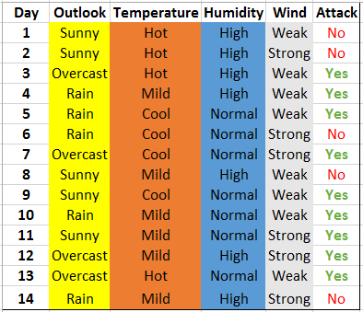
ID3 - Example
Our Naval Fleet game data:

Slide 26
ID3 - Example
Example: Attack or not to attack?
Find entropy of the complete space
Compute Information Gain for each attribute
Select attribute with highest Gain for next node in tree
Repeat steps 1-3
Notes:
Check out the following website for calculating Information Gain: https://planetcalc.com/8421/?license=1

Slide 27
ID3
Consideration:
What about continuous attributes?
  Divide values into small number of discrete categories
  Then run ID3
How to compute log₂(x)?
  In general
  log_{n}(x) = log₁₀(x) / log₁₀(n)
  log₂(x) = log₁₀(x) / log₁₀ (2)

Slide 28
Building Decision Trees
Where do examples come from and whose behaviour would we wish to learn?
  Programmer/designer provides examples
  Capture an expert player’s actions, and the game state, while they play
Number of examples needed depends on difficulty of concept
  Difficulty: Number of tests needed to determine the action
  More is always better
Training set vs. Testing set
  Train on most (75%) of the examples
  Use the rest to validate the learned decision trees by estimating how well the tree does on examples it hasn’t seen
  (This is the typical process of machine learning in general)

Slide 29
Decision Trees Advantages
Simpler, more compact representation
Easy to create and understand
  Can also be represented as rules
Decision trees can be learned
Can handle multiple classes
Provides interpretable decision trees.

Slide 30
Decision Trees Disadvantages
Decision tree engine requires more coding than FSM
  Each tree is “unique” sequence of tests, so little common structure
Need as many examples as possible
Higher CPU cost - but not much higher
Learned decision trees may contain errors
  Might learn the wrong thing
Prone to overfitting, especially with noisy data or when the tree becomes very deep
Is not inherently designed for continuous data
  However, preprocessing can be done to discretise continuous features.

